Slide 1
Stability research plan
Chandler

Slide 2
Action
Rec2000 simulation
Pressure measurement data inversion – get force stimulate.
Calculate the receiver shell vibration, compare it with the result of Polytec laser

Slide 3
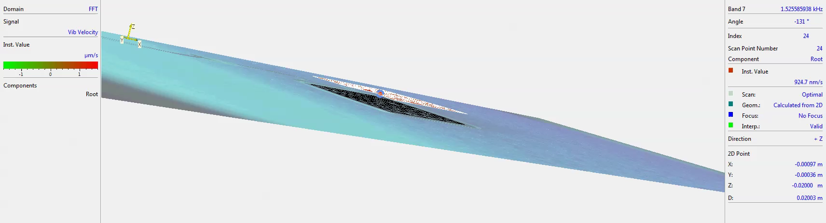
Polytec result Band data – 1st order modal – 1.5kHz

Slide 4
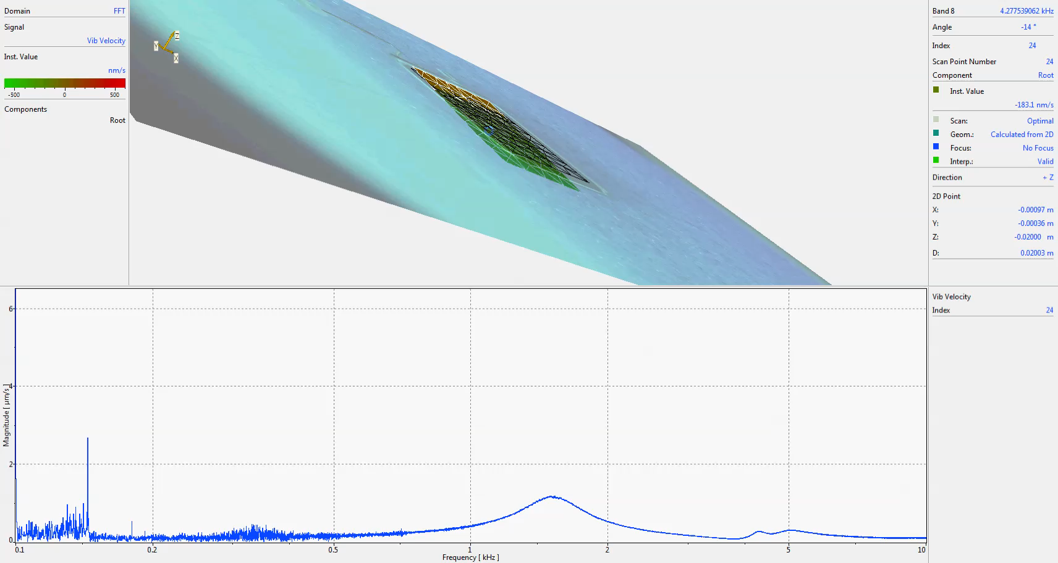
2nd order – 4.2kHz

Slide 5
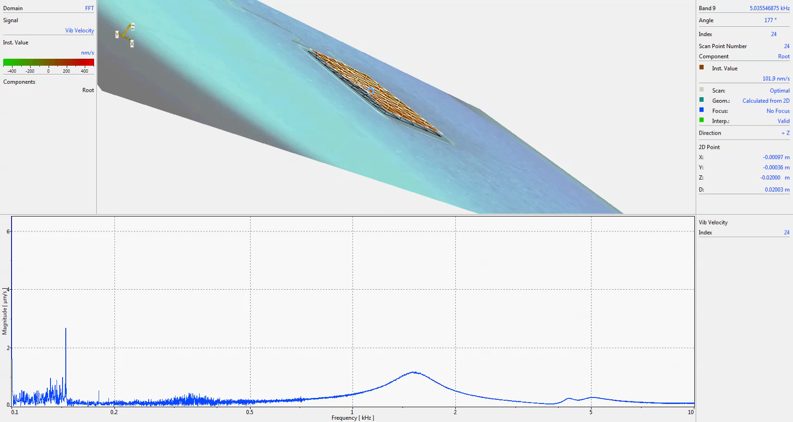
3rd order – 5kHz

Slide 6
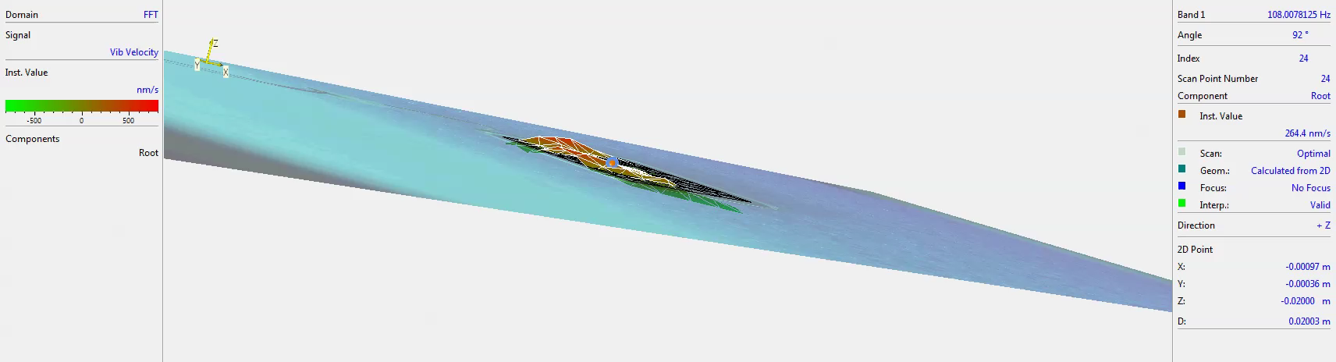
Likely noise

Slide 7
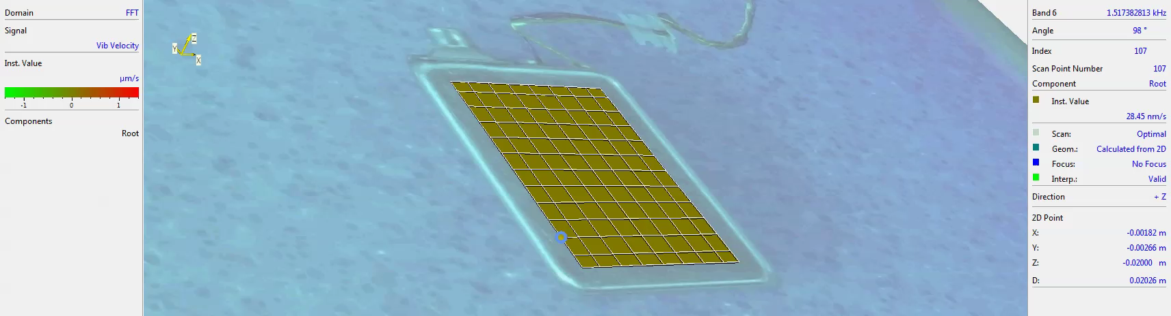
The other side – 1.5k Hz

Slide 8
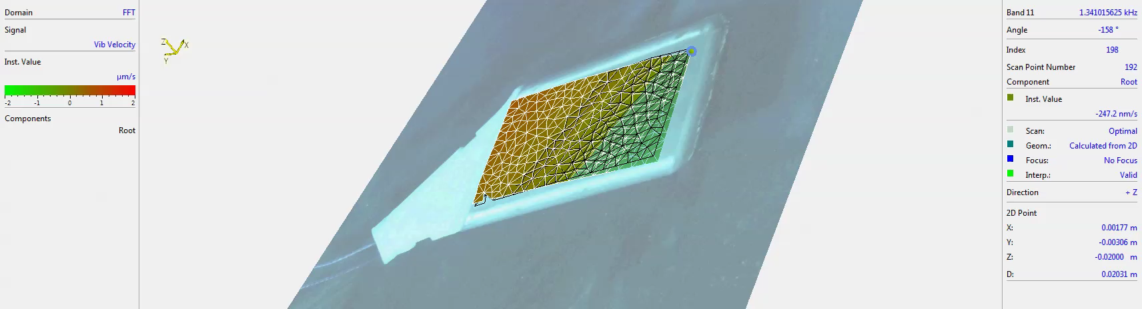
Rec2000 with can – 1.3kHz

Slide 9
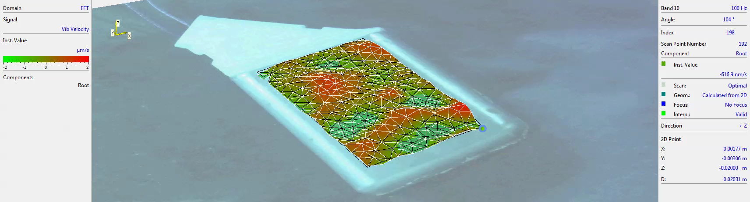
Rec2000 with can – 100Hz

Slide 10
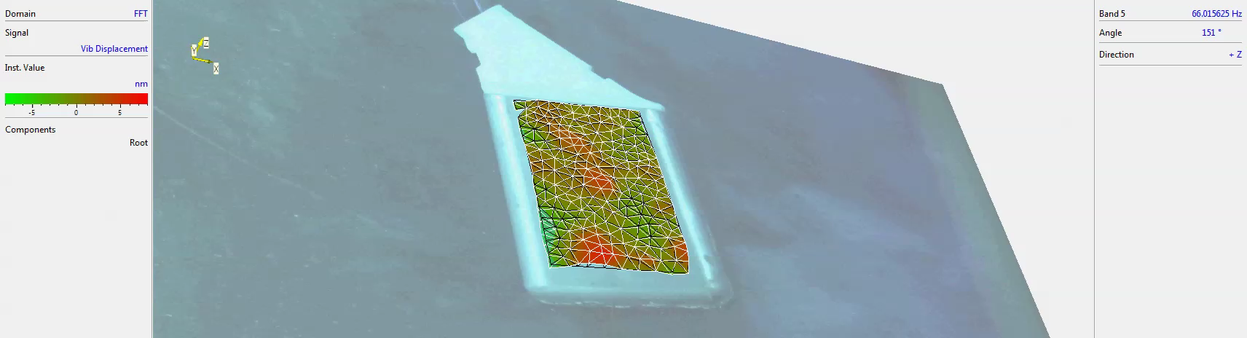
Rec2000 with can – displacement, 66Hz

Slide 11
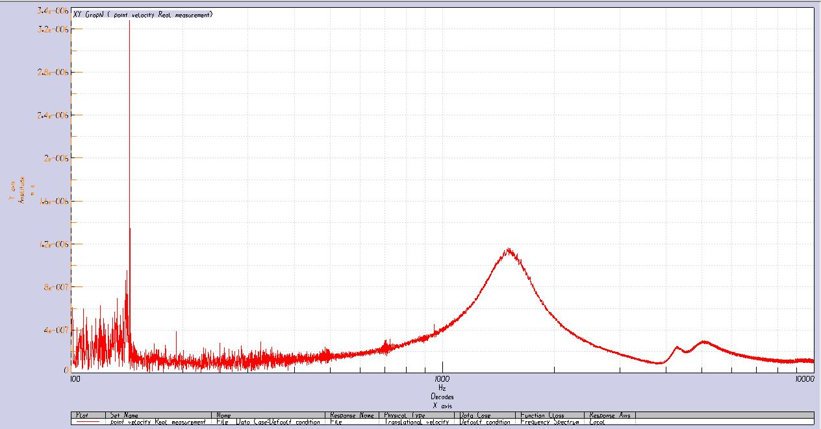
Polytec Point data - Shell center vibration

Slide 12
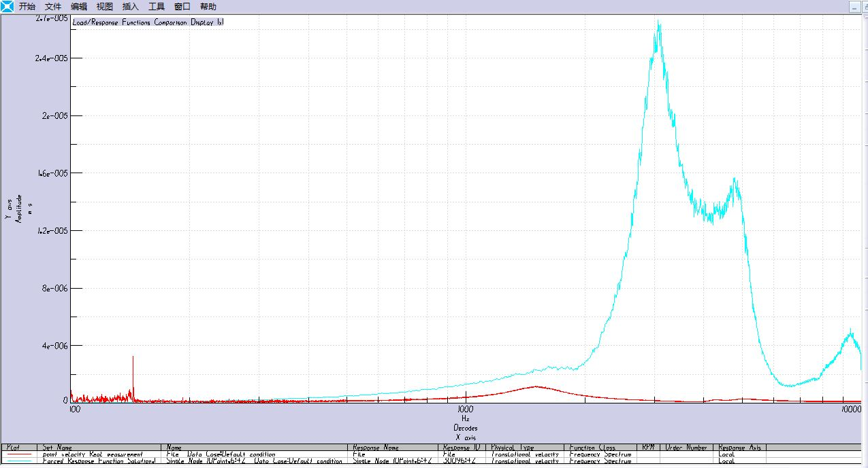
Simulation v.s. real test (Z+ direction)

Slide 13
FEA knowledge learning
LMS Virtual. Lab installation and learning

Slide 14
outline
Keep device vibrate stably to get high gain
EA stability analyze
Measure MSG @ different situations

Slide 15
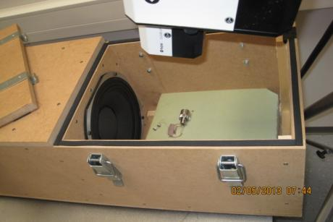
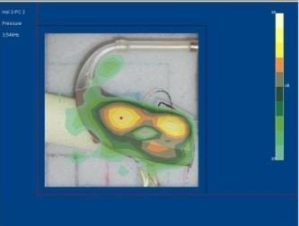
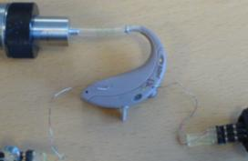
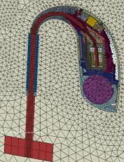
Tools used in EA stability
Laservibrometer
To measure surface velocity on whole device or parts when the receiver is driven and generating vibrations
Modes analysis: A new setup was made during L90 investigations, where an external loudspeaker is playing in a small chamber. These sound pressure variation is making the device vibrate at it’s resonancefrequencies.
Acoustic holography
To measure the radiated sound pressure from a device, and thereby find leakages that needs to be fixed or vibrating parts/plates that needs to be stopped
Loop gain measurements
EA measurement where the loop of instability is opened to measure input/output. The loop is opende between receiver and hybrid.
This is the direct measure of EA stability (closed gain-open loop gain
Finite element modelling
A complete model of the hearing aid is made including the inside air and surrounding air
All tools are used together and supports each other
E.g. if there is a leakage it will only show up in holography measurements and not in laser measurement.
Both laser, holography and loop gain’s are used to validate FE model

Slide 16
EA stability development process (mainly for BTE’s)
The receiver is producing sound with the vibrating membrane inside. This also generates vibrations and sound outside the receiver.
These sound and vibrations are transmitted through the mechanics and picked up by the microphone membranes – which then send an electric signal via the amplifier to the receiver again -> feedback loop
The more we can dampen the feedback loop, by optimising the mechanical parts in material and geometry and shifting around the resonance frequencies for both the mechanical and acoustical system (to avoid coinciding frequencies), the higher gain we can have in the device.

Slide 17
EA stability process
Mockups
Printed or milled parts
Prototype tools
Soft moulded parts
Production tools
Moulded parts in production tools
This stage is ok to get an approximate stability level.
But cannot be used for detailed investigations.
FE model is build and Mockups are used for verification
Better quality than printed parts, but still unprecise parts, which was sensitive to L90 Super power and distorted the stability investigations.
Validate that EA stability can still be obtained.
The rubber parts needs to be moulded in right material
EA stability requirement is to get 90% yield in production (not taken other failures into account) Some extra margin should be added to absorb changes to new tools (production tools)
EA stability requirement is to get 90% yield in production (not taken other failures into account)

Slide 18
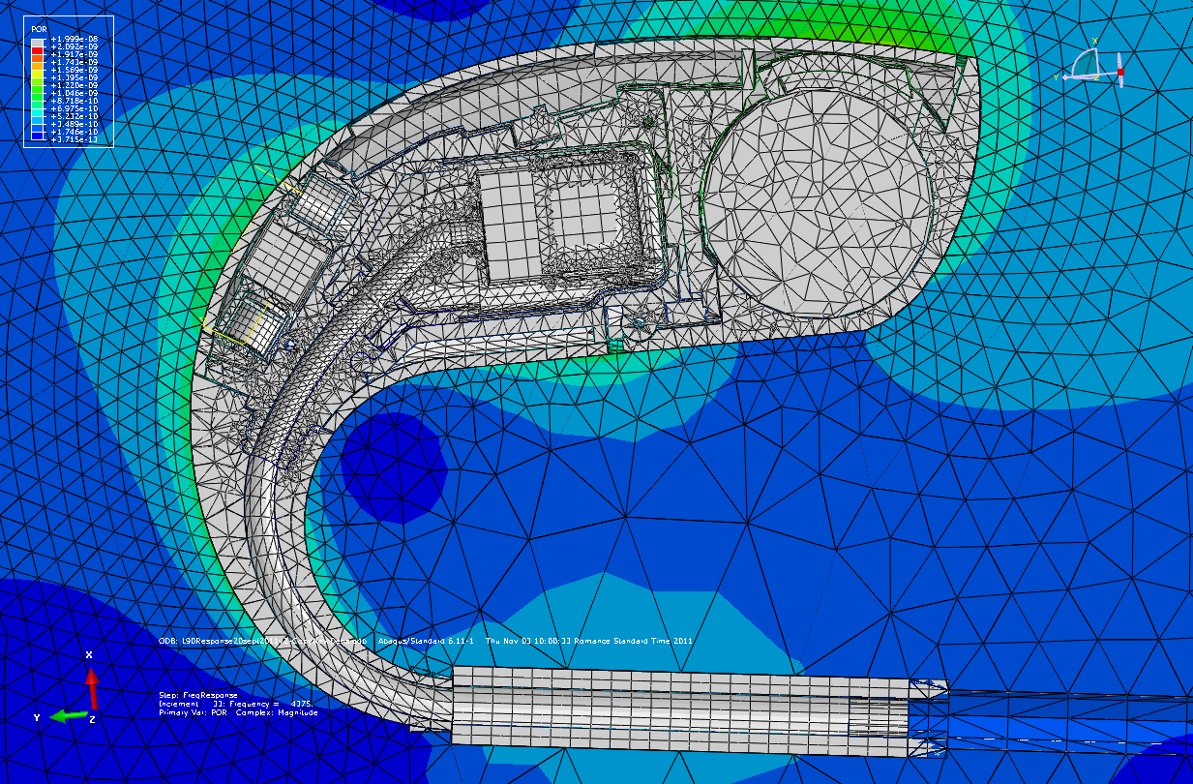
FE Model & Validation

Slide 19
Model resume
Parts are imported from ProE to Abaqus with a translator (plug-in in ProE) so the parts have same position and better geometry for meshing
Model is only containing vibro acoustical important part, so e.g. the following parts are deleted: PCB and components (their weight is added the the frame), battery springs and buttons.
An air bubble is added around the device to be able to simulate the radiated sound pressure caused by vibrations of the device. The outer sourface of the air bubble is absorbing. The radius of the bubble is determining the lowest frequency for the model (1/2 of the wavelength (500Hz, r=(343m/s / 500Hz)/2=343mm. The node density determines the highest frequency with 6 nodes per wavelength (12kHz close to the device gives (343m/s / 12kHz)/6 = 5 mm between nodes. The distance between nodes are increasing the further away from the device you are.
Air inside the sound path and in the microphone are added. To approximate the thermo-viscous damping in air we use practical measurements and correct model with
A PVC tube at the end of the hook is added.
A 2cc coupler and ear mould adapter tube are added. The 2cc coupler is encastred to ”ground” the model.
Receiver model: Vibrating membrane to generate sound pressure in sound path. Forces on receiver to give receiver vibrations
Microphone model: A PET membrane is pre-tensioned (by a temperature drop) and velocity of membrane will correspond to sound pressure particle velocity.
The model consist of 2 million DOF (degrees of freedom) and takes 6 hours to run with 4 CPUs and requires 16 GB RAM.

Slide 20
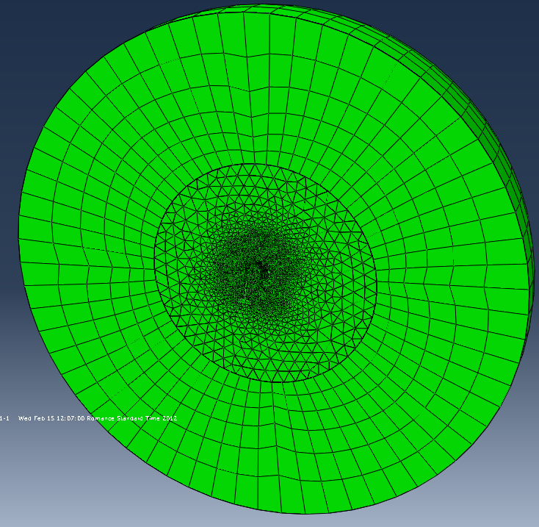
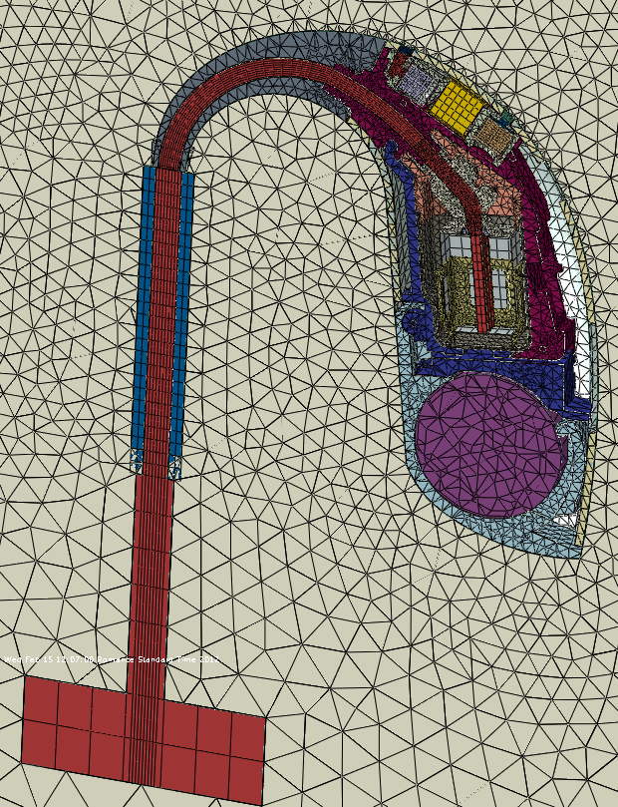
Overview of parts included in model
Airbubble around the device
32 parts, connected by 43 interactions.
1.3 millions DOF (degree of freedoms)
Simulation runtime: 5 – 11 hours depending of complexity of suspension

Slide 21
Stability of production parts
Preparation:
The FE model will be updated with the production parts
Modes analysis
MSG simulation
With new devices we will measure
Open loop gain
Radiated sound with holography
Surface vibrations with laser vibrometri

Slide 22
Improvements for next time
Use more resources on FE simulation
we need to be faster on these tasks and update model whenever new parts are made
Also use FE simulation on assembly process, eg. Assembly and compression of receiver suspension. In Berlin it could be compression of the mic foam
Quality of parts must be better
Protoype tools were worn out and did
Contact between parts must be well defined
We had problems with receiver suspension contact to topchamber (we removed a sleeve that was pressing on the suspension)
The receiver was pushed down in the receiver chamber because the suspension was compressed btwn topchamber and frame snout
Leakage problems at mic suspensions to frame
Hook was too loose to frame
The strong cooperation btwn acoustics-mechanics-operators should have been started earlier in the development
More time should be set a side to look at the builds before measuring them (make x-rays, grinded devices, cut out models (”skue-modeller”),
More EA resources in the beginning af the project
Tasks a la SUMO measurement. Fundamental investigations

